Slide 1
Storing Temporary Data

Slide 2
Table of Contents
Model
ViewBag
ViewData
TempData
Cookies
Session
Application

Slide 3
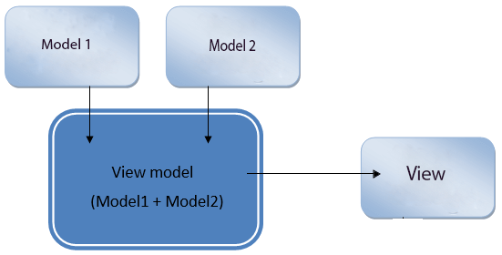
What ViewModel is
In ASP.NET MVC, ViewModels are used to shape multiple entities from one or more models into a single object. This conversion into single object provides us better optimization.

Slide 4
How data is managed with ViewModel
ViewModel provides us proper Separation of Concerns (SoC).
The View needs to only render the single ViewModel object, and there is a specific purpose for each and every aspect of the application, which means the application will be more organized in the code.
Using ViewModel, we put our manipulation code separately in a specific place and away from the View and Controller.
So, it provides us a better SoC and makes our code more maintainable.
It also makes our code more testable because unit testing means testing the small units, and it is easier to test if we separate the manipulation logic in a separate ViewModel.

Slide 5
Where we should use ViewModel?
Managing or creating dropdown lists for a specific entity
Creating Master-Details View in data-driven websites
Used in showing shopping carts on the website
Used in Pagination
Used in a website to show User profile widget
Used to make Dashboards for integrating multiple data into one place
Used as an Aggregate Root to make reports in Domain Driven Design (DDD)

Slide 6
ViewBag, ViewData, and TempData
ViewBag, ViewData, and TempData all are objects in ASP.NET MVC and these are used to pass the data in various scenarios.
The following are the scenarios where we can use these objects.
Pass the data from Controller to View.
Pass the data from one action to another action in the same Controller.
Pass the data in between Controllers.
Pass the data between consecutive requests.

Slide 7
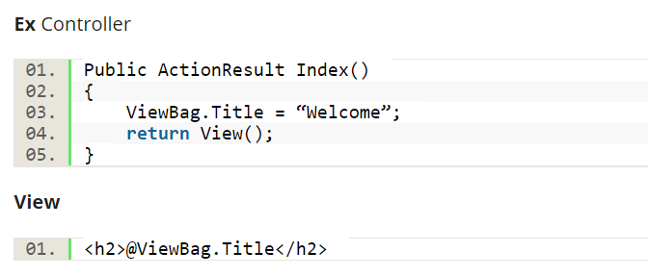
ViewBag
ViewBag is a dynamic object to pass the data from Controller to View. And, this will pass the data as a property of object ViewBag. And we have no need to typecast to read the data or for null checking. The scope of ViewBag is permitted to the current request and the value of ViewBag will become null while redirecting.

Slide 8
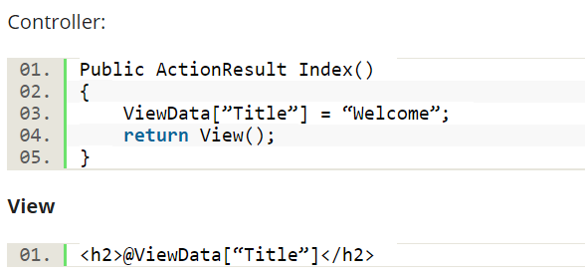
ViewData
ViewData is a dictionary object to pass the data from Controller to View where data is passed in the form of key-value pair. And typecasting is required to read the data in View if the data is complex and we need to ensure null check to avoid null exceptions. The scope of ViewData is similar to ViewBag and it is restricted to the current request and the value of ViewData will become null while redirecting.

Slide 9
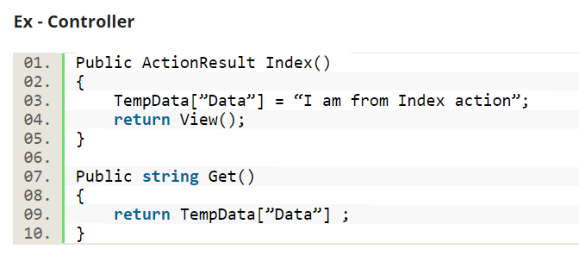
TempData
TempData is a dictionary object to pass the data from one action to other action in the same Controller or different Controllers.
Usually, TempData object will be stored in a session object.
Tempdata is also required to typecast and for null checking before reading data from it.
TempData scope is limited to the next request and if we want Tempdata to be available even further, we should use Keep and peek.

Slide 10
Cookies
Cookies store data across requests. Because cookies are sent with every request, their size should be kept to a minimum. Ideally, only an identifier should be stored in a cookie with the data stored by the app. Most browsers restrict cookie size to 4096 bytes. Only a limited number of cookies are available for each domain.
Because cookies are subject to tampering, they must be validated by the app. Cookies can be deleted by users and expire on clients. However, cookies are generally the most durable form of data persistence on the client.
Cookies are often used for personalization, where content is customized for a known user. The user is only identified and not authenticated in most cases. The cookie can store the user's name, account name, or unique user ID such as a GUID. The cookie can be used to access the user's personalized settings, such as their preferred website background color.
See the European Union General Data Protection Regulations (GDPR) when issuing cookies and dealing with privacy concerns.

Slide 11
Session state
Session state is an ASP.NET Core scenario for storage of user data while the user browses a web app. Session state uses a store maintained by the app to persist data across requests from a client. The session data is backed by a cache and considered ephemeral data. The site should continue to function without the session data.
Critical application data should be stored in the user database and cached in session only as a performance optimization.
ASP.NET Core maintains session state by providing a cookie to the client that contains a session ID. The cookie session ID:
Is sent to the app with each request.
Is used by the app to fetch the session data.

Slide 12
Session state
The session cookie is specific to the browser. Sessions aren't shared across browsers.
Session cookies are deleted when the browser session ends.
If a cookie is received for an expired session, a new session is created that uses the same session cookie.
Empty sessions aren't retained. The session must have at least one value set to persist the session across requests. When a session isn't retained, a new session ID is generated for each new request.
The app retains a session for a limited time after the last request. The app either sets the session timeout or uses the default value of 20 minutes. Session state is ideal for storing user data:
That's specific to a particular session.
Where the data doesn't require permanent storage across sessions.
Session data is deleted either when the ISession.Clear implementation is called or when the session expires.
There's no default mechanism to inform app code that a client browser has been closed or when the session cookie is deleted or expired on the client.
Session state cookies aren't marked essential by default. Session state isn't functional unless tracking is permitted by the site visitor. For more information, see General Data Protection Regulation (GDPR) support in ASP.NET Core.

Slide 13
Configure session state
The Microsoft.AspNetCore.Session package:
Is included implicitly by the framework.
Provides middleware for managing session state.
To enable the session middleware, Startup must contain:
Any of the IDistributedCache memory caches. The IDistributedCache implementation is used as a backing store for session. For more information, see Distributed caching in ASP.NET Core.
A call to AddSession in ConfigureServices.
A call to UseSession in Configure.

Slide 14
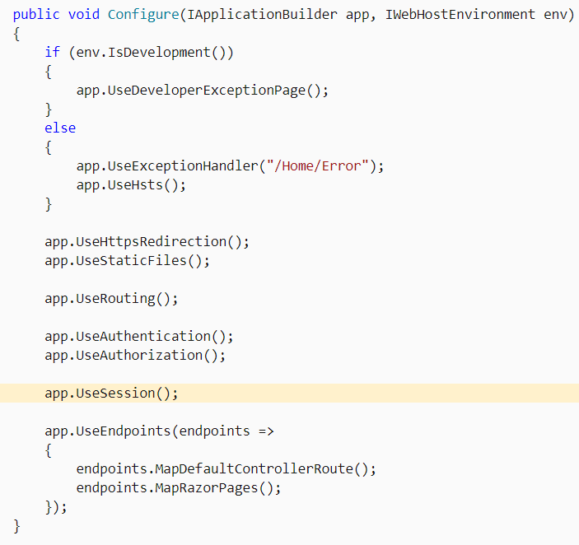
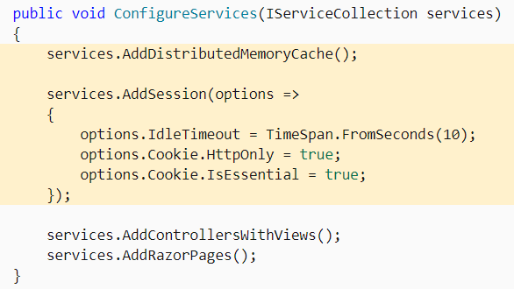
Configure session state

Slide 15
Set and get Session values
Session state is accessed from a Razor Pages PageModel class or MVC Controller class with HttpContext.Session. This property is an ISession implementation.
The ISession implementation provides several extension methods to set and retrieve integer and string values. The extension methods are in the Microsoft.AspNetCore.Http namespace.
ISession extension methods:
Get(ISession, String)
GetInt32(ISession, String)
GetString(ISession, String)
SetInt32(ISession, String, Int32)
SetString(ISession, String, String)

Slide 16
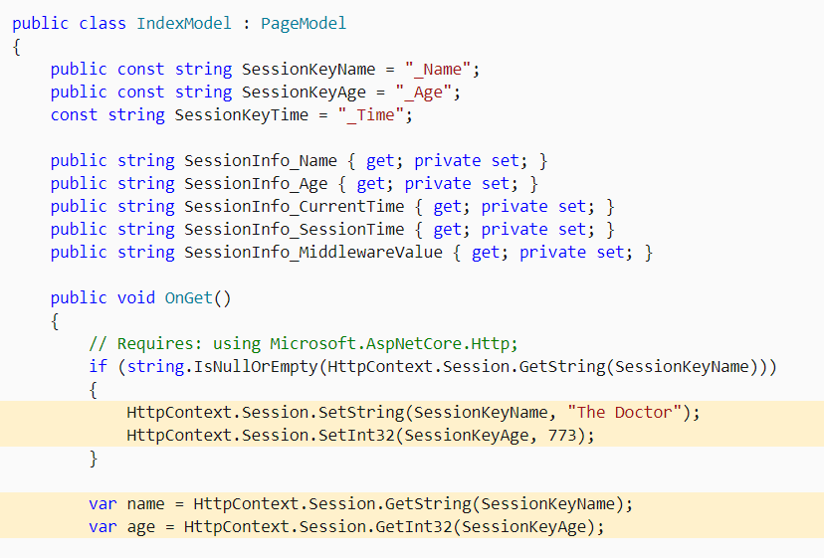
Set and get Session values

Slide 17
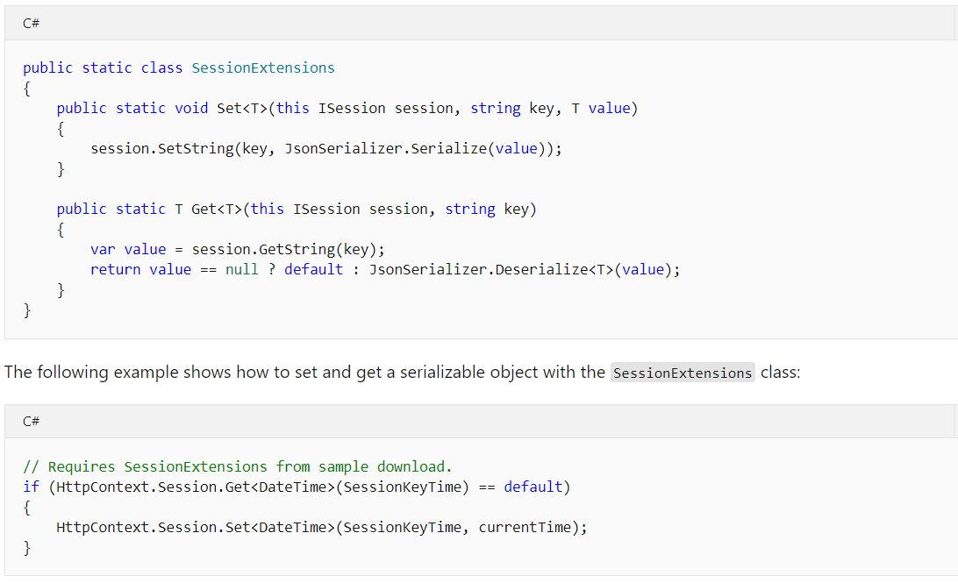
Serialize objects to store in Session

Slide 18
Cache
Caching can significantly improve the performance and scalability of an app by reducing the work required to generate content. Caching works best with data that changes infrequently and is expensive to generate. Caching makes a copy of data that can be returned much faster than from the source. Apps should be written and tested to never depend on cached data.
ASP.NET Core supports several different caches. The simplest cache is based on the IMemoryCache. IMemoryCache represents a cache stored in the memory of the web server. Apps running on a server farm (multiple servers) should ensure sessions are sticky when using the in-memory cache. Sticky sessions ensure that subsequent requests from a client all go to the same server. For example, Azure Web apps use Application Request Routing (ARR) to route all subsequent requests to the same server.
Non-sticky sessions in a web farm require a distributed cache to avoid cache consistency problems. For some apps, a distributed cache can support higher scale-out than an in-memory cache. Using a distributed cache offloads the cache memory to an external process.
The in-memory cache can store any object. The distributed cache interface is limited to byte[]. The in-memory and distributed cache store cache items as key-value pairs.

Slide 19
Other options
Query strings - A limited amount of data can be passed from one request to another by adding it to the new request's query string. This is useful for capturing state in a persistent manner that allows links with embedded state to be shared through email or social networks. Because URL query strings are public, never use query strings for sensitive data.
Hidden fields - Data can be saved in hidden form fields and posted back on the next request. This is common in multi-page forms. Because the client can potentially tamper with the data, the app must always revalidate the data stored in hidden fields.
HttpContext.Items - The HttpContext.Items collection is used to store data while processing a single request. The collection's contents are discarded after a request is processed. The Items collection is often used to allow components or middleware to communicate when they operate at different points in time during a request and have no direct way to pass parameters.

Slide 20
References
https://www.c-sharpcorner.com/article/managing-data-with-viewmodel-in-asp-net-mvc
https://www.c-sharpcorner.com/blogs/viewbag-viewdata-and-tempdata-in-mvc
https://www.c-sharpcorner.com/blogs/viewdata-vs-viewbag-vs-tempdata-in-mvc1
https://docs.microsoft.com/en-us/aspnet/core/fundamentals/app-state
https://www.c-sharpcorner.com/article/how-to-use-session-in-asp-net-core/
https://docs.microsoft.com/en-us/aspnet/core/performance/caching/memory

